Slide 1


Slide 2
Chapter Outline
Models
Frameworks
Standards
Methodologies

Slide 3
Models & Framework
Model is a high level construct representing processes, variables and relationships. Thus, model is an abstract, conceptual construct without providing specific guidance on or practices for implementation.
A framework is defined as a support structure in which another software project can be organized or developed.
While a model is abstract and conceptual, a framework is linked to demonstrable work. Furthermore, frameworks set assumptions and practices that are designed to directly impact implementations. In contrast, models provide the general guidance for achieving the goals, but without getting into the details of practice and procedures.

Slide 4
Standards
A standard is a published document that contains a technical specification or other precise criterion designed to be used consistently as a rule, guideline or definition.
Standards help to make life simpler and to increase the reliability and effectiveness of many goods and services that we use.
They are the summary of best practices and are created by bringing together the experiences and expertise of all interested parties- the producers, sellers, buyers, users and regulators of a particular material, product, process or service.
An important point to note is that standards are designed for voluntary use and do not impose any regulations.
However, laws and regulations may refer to certain standards, and make compliance with them compulsory.

Slide 5
Methodology
A methodology is a codified set of recommended practices, sometimes accompanied by training materials, formal educational programs, worksheets and diagramming tools.
It is ‘a body of practices, procedures and rules used by those who work in a discipline or engage in an inquiry.’

Slide 6
Topics to be covered
ISO 27001 (Framework/Standard)
COBIT (Framework/Standard)
SSE-CMM: System Security Engineering Capability Maturity model (Framework)
Methodologies for IS security
  IAM: InfoSec assessment methodology
  IEM: InfoSec evaluation methodology
  SIPES: Security incident policy enforcement system

Slide 7
ISO 27001
It is an ISM standard.
Its purpose is to help organizations to establish and maintain the ISMS.
It is the set of requirements that must be met if you want your ISMS to be formally certified.
Being ISO 27001 approved is a certification which shows that the business has defined and implemented effective security process.

Slide 8
ISO 27001
ISO 27001 (formally known as ISO/IEC 17799:2005) is a specification for an information security management system (ISMS).
An ISMS is a framework of policies and procedures that includes all legal, physical and technical controls involved in an organization's information risk management processes.
According to its documentation, ISO 27001 was developed to "provide a model for establishing, implementing, operating, monitoring, reviewing, maintaining and improving an information security management system."

Slide 9
ISO 27001 uses a top-down, risk-based approach and is technology-neutral. The specification defines a six-part planning process:
Define a security policy.
Define the scope of the ISMS.
Conduct a risk assessment.
Manage identified risks.
Select control objectives and controls to be implemented.
Prepare a statement of applicability.

Slide 10
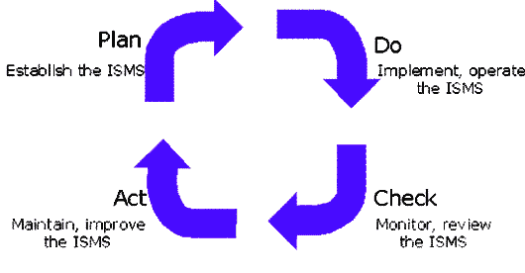
PDCA Approach

Slide 11
PLAN-Establish content
Define ISMS scope
Define policy
Identify risks
Assess risks
Select control objectives

Slide 12
2. DO-Implement and operate
Implement risk treatment plan
Deploy controls

Slide 13
3. CHECK- Monitor and review
Monitor processes
Regular reviews
Internal audits

Slide 14
4. ACT-Maintain and improve
Implement improvements
Corrective actions
Preventive actions
Communicate with stakeholders

Slide 15
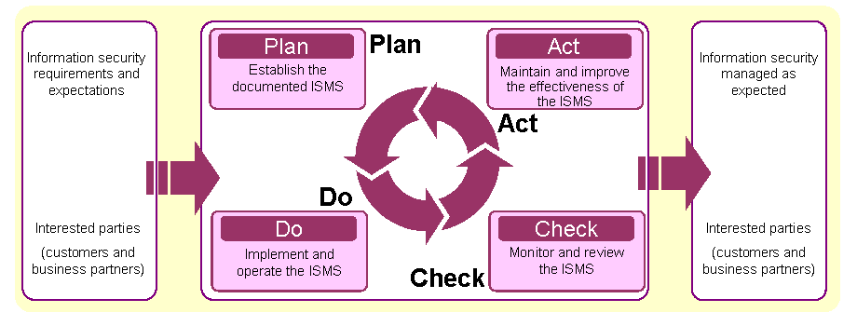
Implementation context of PDCA cycle in ISO 27001

Slide 16
The specification includes details for documentation, management responsibility, internal audits, continual improvement, and corrective and preventive action. The standard requires cooperation among all sections of an organization.
The 27001 standard does not mandate specific information security controls, but it provides a checklist of controls that should be considered in the accompanying code of practice, ISO/IEC 27002:2005. This second standard describes a comprehensive set of information security control objectives and a set of generally accepted good practice security controls.

Slide 17
ISO 27001 is designed to help organizations establish and maintain effective information security controls through continual improvements.
Developed in October, 2005 by International standards Organization, ISO 27001 implements principles of the Organization for Economic Cooperation and Development(OECD) on governing the security of information and networks.
The standard creates a road map for the secure design, implementation, management and maintenance of IT processes in the organization.

Slide 18
COBIT
COBIT is a framework for developing, implementing, monitoring and improving information technology (IT) governance and management practices.
The COBIT framework is published by the IT Governance Institute and the Information Systems Audit and Control Association (ISACA).
The goal of the framework is to provide a common language for business executives to communicate with each other about goals, objectives and results.
The original version, published in 1996, focused largely on auditing. The latest version, published in 2013, emphasizes the value that information governance can provide to a business' success.
It also provides quite a bit of advice about enterprise risk management.

Slide 19
COBIT
The name COBIT originally stood for "Control Objectives for Information and Related Technology," but the spelled-out version of the name was dropped in favor of the acronym in the fifth iteration of the framework.
COBIT 5 is based on five key principles for governance and management of enterprise IT:
Principle 1: Meeting Stakeholder Needs
Principle 2: Covering the Enterprise End-to-End
Principle 3: Applying a Single, Integrated Framework
Principle 4: Enabling a Holistic Approach
Principle 5: Separating Governance From Management
( Holistic: characterized by the belief that the parts of something are intimately interconnected and explicable only by reference to the whole.)

Slide 20
SSE-CMM
Official name: System security engineering capability
Abbreviations: SSE-CMM
ISO/IEC 21827
A process reference model

Slide 21
SSE-CMM
It is focused on the requirements for implementing security in a system or series of related systems that are the information technology security domain.
Of all the models, frameworks and standards discussed, SSE-CMM is the most difficult to classify.
At face value, it may seem to belong under the classification of model but taxonomically SSE-CMM is classified as a framework.

Slide 22
SSE-CMM
SSE-CMM is a general framework for implementing security engineering within an organization, preferably in conjunction with other engineering CMMs.
SSE-CMM focus on process definition and improvement as a core value.
SSE-CMM looks at the occurrence of security defects or incidents, and seeks to identify the flaw in the related process so as to remediate the flaw, thus removing the overall defect.

Slide 23
SSE-CMM
SSE-CMM is a very strong, well tested framework for integration into an engineering oriented organization.
If an organization performs engineering, such as through product development, then the use of SSE-CMM, particularly in combination with other CMMs would be very valuable.

Slide 24
Security Policy
SECURITY POLICY is a set of policies issued by an organization to ensure that all information technology users within the domain of the organization or its networks comply with rules and guidelines related to the security of the information stored digitally at any point in the network or within the organization's boundaries of authority.

Slide 25
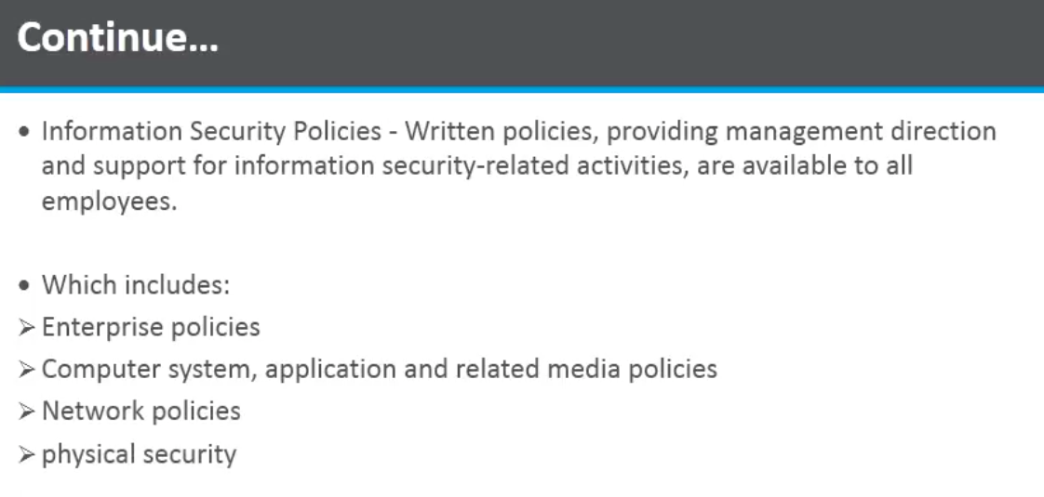

Slide 26
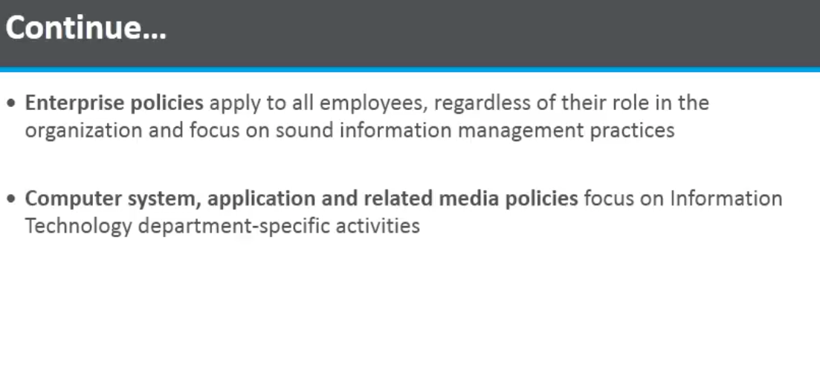

Slide 27
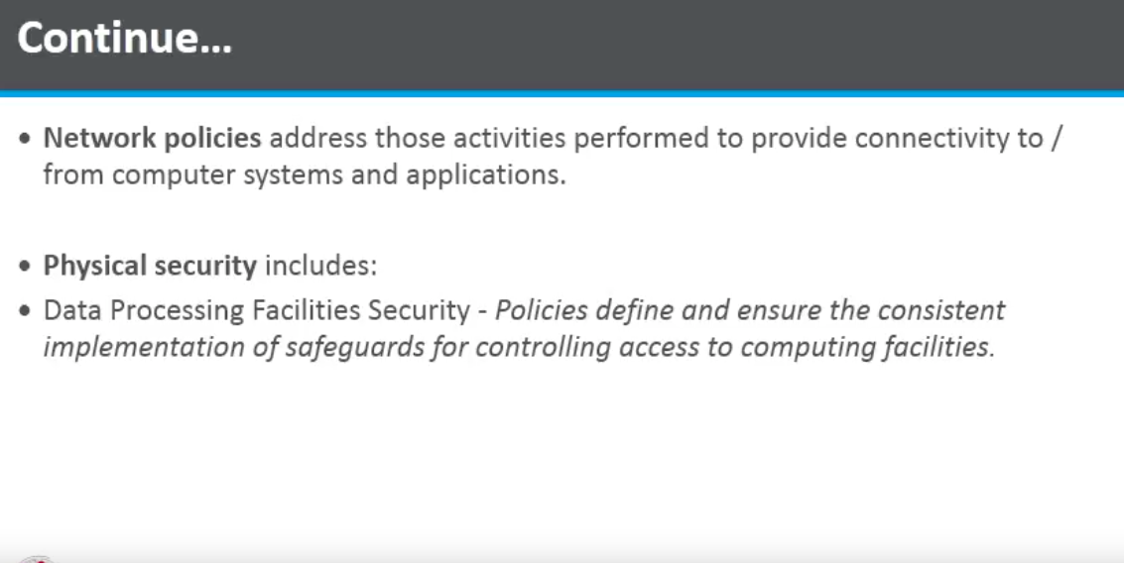

Slide 28
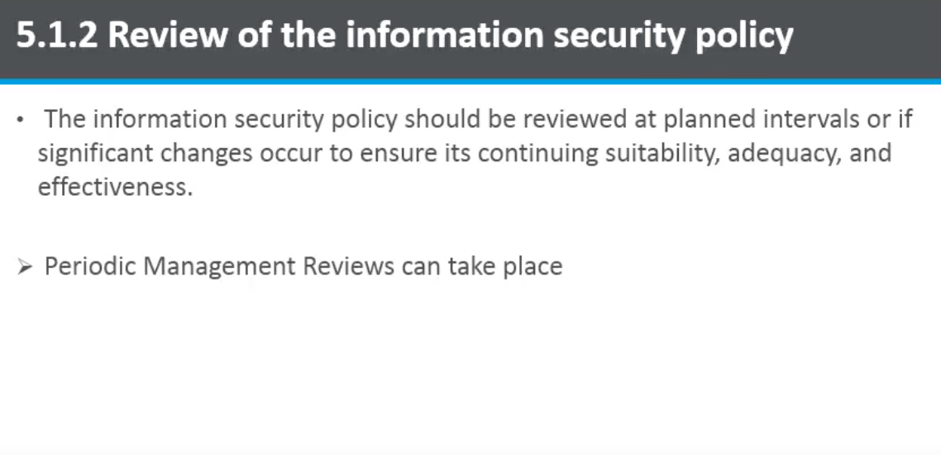

Slide 29
Methodologies
IAM
IEM
SIPES

Slide 30
IAM
Objective: to provide a method that can be used as a standardized baseline for the analysis of Infosec posture of automated information systems.
Three phases:
  Pre-assessment
  On-site activities
  Post assessment

Slide 31
IAM
Pre-assessment
  Intended to develop a general understanding of customer needs, identify target systems and establish the ‘ rules of engagement’ for assessment.
  It concludes with a written assessment plan.
On site activities
  This phase represents primary thrust of IAM in that it takes the results of pre-assessment phase, validate those results and perform additional data gathering and validation.
  The result of this phase is a report of initial analysis
Post assessment phase
  It concludes the IAM by pulling together all details from previous two phases, combining them into final analysis and report .

Slide 32
IEM
Objective: to provide a method for technically assessing vulnerability in systems and to validate the actual Infosec posture of those systems.
IEM is a companion methodology to IAM fitting under the umbrella of IA-CMM(Infosec assurance capability maturity model) framework.
Key difference between IAM and IEM is that IEM performs actual hands on assessment of systems in order to validate the actual existence of vulnerabilities, as opposed to IAM’s result of document-possible vulnerabilities in those systems.

Slide 33
IEM
Three phases:
  Pre evaluation
  On-site evaluation
  Post evaluation

Slide 34
IEM
Pre-evaluation
  Takes IAM pre assessment report as input and then coordinate the rules of engagement for conducting a technical evaluation of systems
  Concludes with a technical evaluation plan.
On-site
  Represents bulk of hands-on technical work, performing various discoveries, scans and evaluations.
  All findings are manually validated to ensure accuracy
Post-evaluation
  Concludes the methodology in a manner similar to IAM by pulling together all data generated , putting them into a final report that details findings, recommendations and a security road map.

Slide 35
SIPES
Security incident policy enforcement system.
The right security incident policies and procedures can save a network after a security breach.
An efficient incident policy minimize the damage after such a breach.
These policies may be in the form of standalone documentation, or they may be incorporated into other documentation such as company security policies or disaster recovery plans.
SIPES aims at providing a methodology for defining and implementing a security incident policy enforcement system.
The SIPES draft represents a relatively abstract approach to addressing the problem of incident response management.

